Slide 1
The Club Executive Committee
LACE 2014
Building Teamwork in Our Clubs
Lorrie Briscoe, DTM

Slide 2
Agenda
Club Executive Committee Members
The Role of the Club Executive Committee
Order of the Agenda
Components of the Meeting
Meeting Agenda Sample
Tools to Succeed

Slide 3
Club Executive Committee Members
President
Vice President Education (VPE)
Vice President Membership (VPM)
Vice President Public Relations (VPPR)
Secretary
Treasurer
Sergeant-at-Arms (SAA)
Immediate Past President (IPP)

Slide 4
Role of the Club Executive Committee
Hold Regular Executive Committee Meetings
Create a Budget
Complete a Club Success Plan
Strategize Success in the Distinguished Club Plan
Encourage Participation in the Distinguished Member Program
Create and Oversee Other Club Committees as Necessary

Slide 5
Order of the Agenda
President Calls Meeting to Order
Reading of the Minutes from the Last Meeting
Vote to Approve
Officer Reports
Unfinished Business Items
New Business
Announcements and Closing Thoughts
Adjournment

Slide 6
Components of the Meeting
Procedure
Keep it Organized and Productive
Use Parliamentary Procedures (Robert’s Rules of Order)
President Sets the Tone – Serves as a Role Model
Shows Respect to Other Committee Members

Slide 7
Components of the Meeting (Continued)
Pace
Maintain a Fast Pace
Keep the Meeting Short
Participation
All Committee Members Should Provide a Report
If they don’t have anything to report, encourage participation

Slide 8
Components of the Meeting (Continued)
Review
Keep Track of Club Goals
Distinguished Member Plan
Distinguished Club Program
Club Success Plan

Slide 9
Components of the Meeting (Continued)
Forward Thinking
Discuss Items to be Included on the Next Agenda
Action Items, Officer Responsible
Club Contest Planning
Year End Awards
Creativity
Don’t Get Stuck in the “We’ve Always Done it This Way”
Encourage Members to Think Creatively
Propose New Ideas

Slide 10
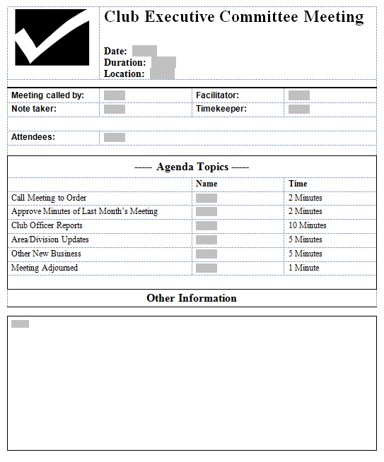
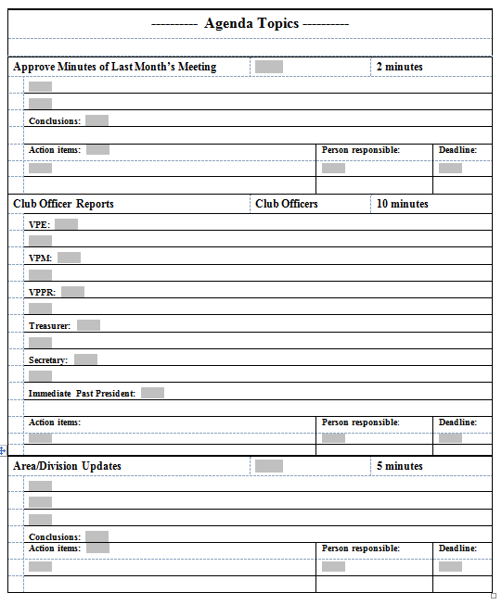
Meeting Agenda Sample

Slide 11
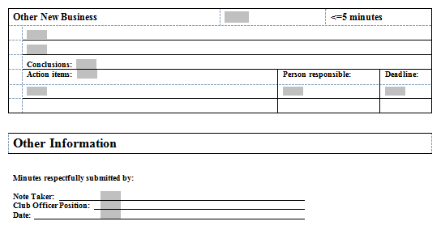
Meeting Agenda Sample (Continued)

Slide 12
Create a Budget
How Should Club Funds (Dues) be Spent?
Meeting Location
Branding Materials
Club Banner
Lectern
Educational Materials
Ribbons
Manuals
LACE Training Paid for Club Officers
Recommendations Need to be Voted on By Club Members

Slide 13
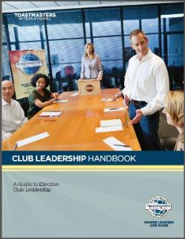
Club Leadership Handbook
Club Executive Committee (Pgs. 11 - 13)
All Officers Should Have a Copy
Can Be Downloaded for Free from the Toastmasters International Website

Slide 14
DCP and Club Success Plan

Slide 15
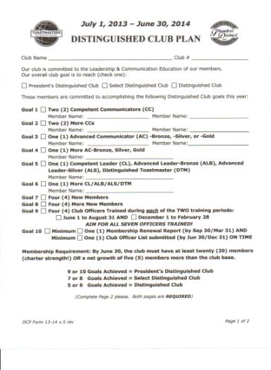
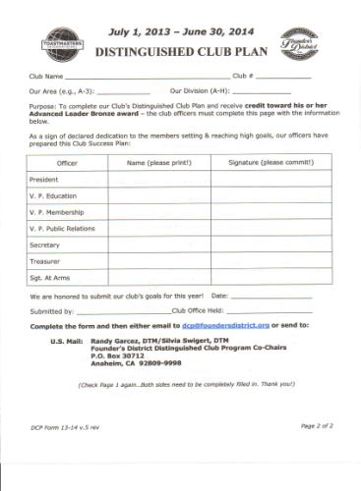
Distinguished Club Plan

Slide 16
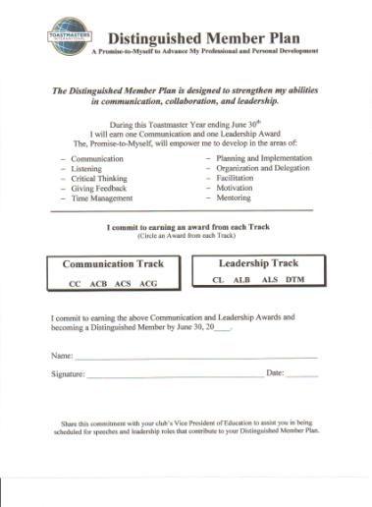
Distinguished Member Plan

Slide 17
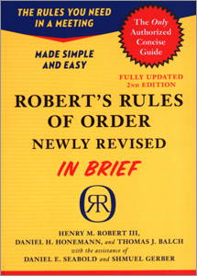
Robert’s Rules of Order

Slide 18
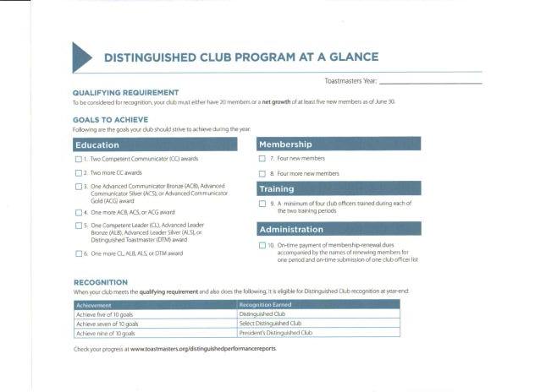
Distinguished Club Program at a Glance

Slide 19
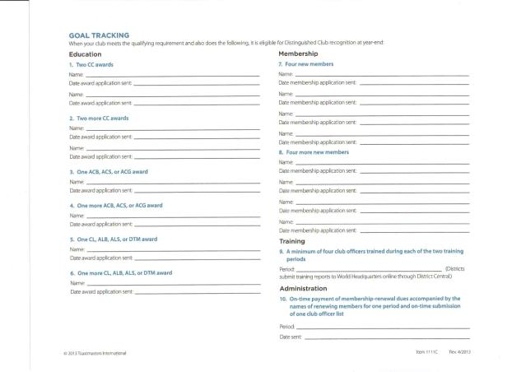
Distinguished Club Program Goal Tracking

Slide 20
Resources
Club Leadership Handbook (Item 1111) http://www.toastmasters.org/CLH
Distinguished Club Program and Club Success Plan http://www.toastmasters.org/1111 http://www.foundersdistrict.org/distinguished-club-program
Distinguished Member Plan http://www.foundersdistrict.org/distinguished-member-plan
Robert’s Rules of Order http://www.amazon.com/s/ref=nb_sb_noss?url=search-alias%3Dstripbooks&field-keywords=Robert's%20Rules%20of%20Order%20in%20Brief
Henderson’s Parliamentary Guide http://www.toastmasters.org/MainMenuCategories/Shop/ManualsBooksVideosCDs_1/Books/ParliamentaryProcedure/HENDERSONSPARLIAMENTARYGUIDE96.aspx

Slide 21
Thank You for Attending The Club Executive Committee
LACE 2014
Building Teamwork in Our Clubs
Lorrie Briscoe, DTM
BriscoeLJ@aol.com

